Slide 1


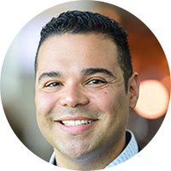
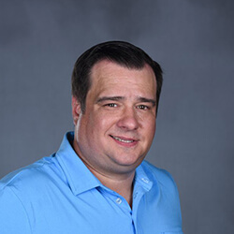
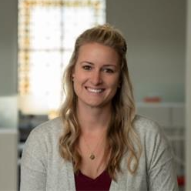
Eddie Castro
Regional Practice Leader
at Roundstone
Sam Walters
Regional Practice Leader
at Roundstone
PART ONE
Client Advocacy and Plan Excellence: Essential Insights for Account Managers
Sophia Corrigan
Customer Outcomes Manager
at Roundstone

Slide 2

Meet Roundstone
Quality, Affordable Healthcare and a Better Life for All
Launched 1st Group Medical Captive in 2005
Total healthcare spend covered
$1,500,000,000
90+%
Average distribution
to captive participants
10.4%*
Retention Rate
*Based on last 5 years
1000+
Number of employers
Across All
50
States
Privately Held in Lakewood, OH
Number of lives covered
170,000+
160+ employees dedicated to YOU!

Slide 3

20 – 500
Employees
Sees the
Long-Term
Strategy
Meet the Average
Roundstone Customer
Wants to
Recruit & Retain
Top Talent
Employees
are an Asset
Innovative
and Engaged
Leadership

Slide 4



Your Funding Options
FULLY INSURED
100% Fixed Costs
The insurance carrier keeps all the profits with zero reporting back to the employers.
In other words…
the traditional model.
LEVEL-FUNDING
~60% Fixed Costs
The employer assumes claims volatility AND the insurance company keeps some of the profits.
In other words…
dipping your toe in.
SELF-FUNDING
~40% Fixed Costs
The employer pays medical claims and buys stop loss insurance to protect against high-cost claims.
In other words…
you’re on an island.

Slide 5

Your Funding Options
SELF-FUNDING WITH OUR GROUP MEDICAL CAPTIVE
15% Fixed Costs
A health insurance pool formed by companies to reduce the cost of their medical benefit spend where the employers gain information, control, savings, and quality.
In other words…
THE BETTER ALTERNATIVE!

Slide 6
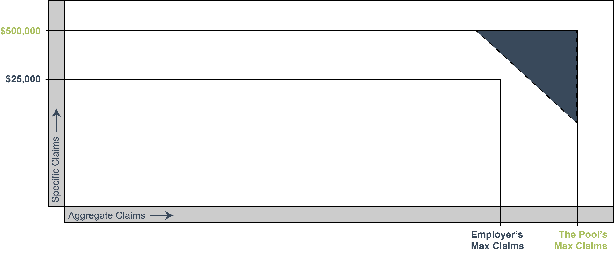
How the Captive Works
Reinsurance (Risk Shifting) = For claims above $500,000 and 125% of expected, reinsurance is purchased.
Pool Premium (Risk Sharing) = For claims between $25,000 and $500,000, employers pool stop loss premiums and claims.
Reserves
Employer Claims Account (Risk Taking) = Each employer will self insure at least $25,000 of claims per member, per policy period.

Slide 7



Client Satisfaction and Retention
We Make It Easy: Simple RFP Process
Open Platform: Flexible Partnership Choices
Strategic Vetting: Partner Scorecards and Solution Vetting

Slide 8




Superior Service and Support
Proactive Support
Cost Containment Recommendation
Captive Performance Statement
Pre-Renewal Communication

Slide 9
Satisfaction and Retention Stats
90% of Our
Groups Renew
Average Immature Renewals:
10-15%
Distribution History of 10% over the
last 5 Years
Average Mature Renewals: 3-5%

Slide 10
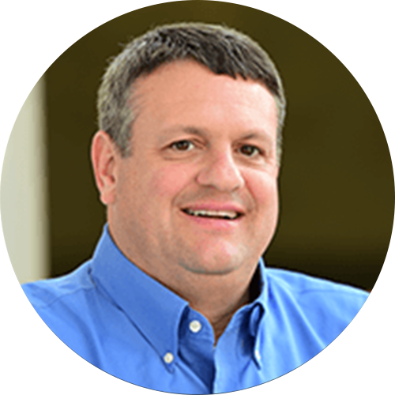
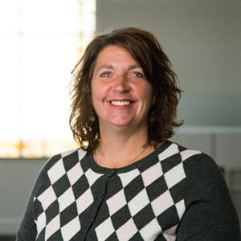
Eddie Castro
Regional Practice Leader
at Roundstone
PART TWO
Bob Pace
Regional Practice Leader
at Roundstone
How to Read a Roundstone Proposal: Mastering Funding Comparisons
SEPTEMBER 24TH AT 2:OO PM EST
Jennifer Trudel
Customer Outcomes Manager
at Roundstone

Slide 11
Q&A

