Slide 1




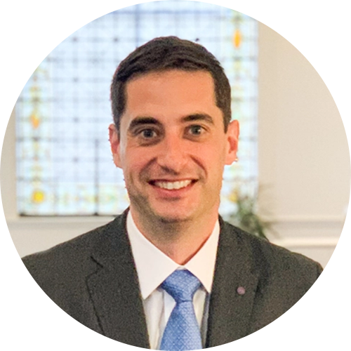
Mike Schroeder
Founder and President
at Roundstone
THE DISTRIBUTION EXPLAINED
Rob Hamilton
Executive VP of Sales
at Roundstone
How Roundstone Has Delivered $91.8 Million in Surplus Back to Employer Clients
Jonathan McCorkle
Chief Financial Officer
at Roundstone

Slide 2

Meet Roundstone
Quality, Affordable Healthcare and a Better Life for All
Launched 1st Group Medical Captive in 2005
Total healthcare spend covered
$1,500,000,000
90+%
Average distribution
to captive participants
10.4%*
Retention Rate
*Based on last 5 years
1000+
Number of employers
Across All
50
States
Privately Held in Lakewood, OH
Number of lives covered
170,000+
160+ employees dedicated to YOU!

Slide 3
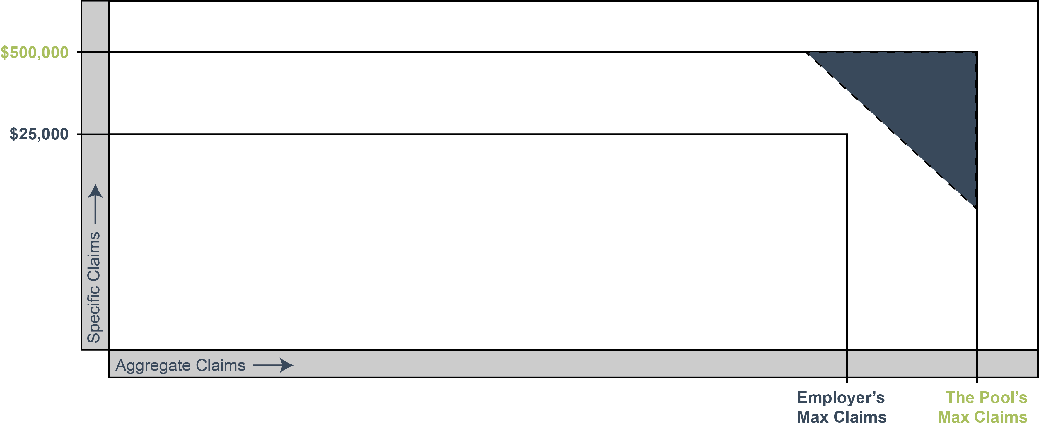
How the Captive Works
Reinsurance (Risk Shifting) = For claims above $500,000 and 125% of expected, reinsurance is purchased.
Pool Premium (Risk Sharing) = For claims between $25,000 and $500,000, employers pool stop loss premiums and claims.
Reserves
Employer Claims Account (Risk Taking) = Each employer will self insure at least $25,000 of claims per member, per policy period.

Slide 4






Cost Savings: 3 Ways to Save
Claims Account
Pharmacy Rebates
Distributions
Employers only pay for the healthcare they consume. All savings from the claims account stay with them.
Transparent and pass-through PBMs (Pharmacy Benefits Managers) send 100% of rebates and pharmacy savings back to employers.
Unused premium from employers’ pooled captive funds are returned annually to employer clients on
a pro rata basis.

Slide 5

What is a Captive Distribution?
The Captive Loss Fund (Return Fund) is the pool of funds accumulated from the stop-loss premium.
Reinsurance (Risk Shifting)
Pool Premium (Risk Sharing) = Return Fund
Reserves
Employer Claims Account (Risk Taking)

Slide 6

Our Guarantee to You
By participating in our group medical captive, with its focus on cost containment and control, we guarantee that you will save money in the first five years or we’ll make up the difference.

Slide 7
Vetted Partnerships: Criteria
TPA
NETWORK
PBM
Claim Quality
Network Availability
Program Pricing
Ops and Sales
Responsiveness/Collaboration
CSI Integration
Cost Containment
Stop Loss Ratio
Renewal/Win Rate
Onboarding Experience
Pricing
Network Footprint / Wrap Network
Network Stability​
Appropriateness by State​
Minimum Lives Requirements​
Group Size Limitations​
Investments​
Tech Integration
Competitive Net Costs (Ingredient, Rebates, Administrative Costs)
Member Focused Cost Containment
Good Partnership Metrics
Onboarding Experience
Administrative Fee Structure
Competitive/Business Landscape
Notes:
PBM​
Competitive Net Costs​
Partner PBMs perform regular claims repricing. ​
This allows for apples-to-apples comparison on measures like ingredient costs, rebates, and administrative costs.​
Roundstone’s cost containment team audits PBM repricing to ensure PBMs make reasonable judgments in their analyses.​
​
Member-focused Cost Containment​
The CSI team assesses the availability of (or willingness to work with) Specialty Rx solutions, the fairness of those solution’' fee structures, and how easily they can be implemented.​
The CSI team also rates our partner PBMs’ approach to clinical management (what the PBM offers to improve the overall health of the member).​
​
Good Partnership Metrics​
PBM is rated according to responsiveness, willingness to provide estimates for Underwriting, and onboarding support.​
​
Onboarding Experience​
Reasonable onboarding timeline (30 to 45 days). PBMs onboarding should be able to join calls with TPA onboarding team.​
​
Competitive/Business Landscape​
No preferred partnerships with Roundstone competitors. In business at least 5 years and no private equity ownership.​
​
Administrative Fee Structure​
PBM should disclosed how it gets paid - ideally per script admin or per member/subscriber admin. fees that do not incentivize high-cost medications​

Slide 8
High Performance Captive Health Plan
Independent TPA with
Cost Saving Plan
Document Language
PBM Carve-out/Overlay
Current Plan Design
Concierge/Digital Health
Biometric Screening and Wellbeing Incentive for Employee
Data Analytics and Forum Attendance
Plan Reviewed for Customized Cost and Risk Management Opportunities
Incentive Based Plan Design
Centers of Excellence/ Specialty Networks
Data Analytics and Forum Attendance
Plan Review for Customized Cost and Risk Management Opportunities
Rx Formulary Review and Revision
Network Strategy Review (RBP, DPC)
YEAR ONE:
The Foundation
YEAR TWO:
The Four Walls
YEAR THREE:
The Roof

Slide 9
How’s Our Cost Containment Different?
REASON 1
REASON 2
REASON 3
Quality, Affordable Healthcare.
With a smarter approach to healthcare, our cost containment solutions do not sacrifice quality of care.
Total Control Over Your Benefits Plan.
Our guided approach prioritizes flexibility through suggested solutions.
You’re never forced to do anything.
Complete Transparency.
Our recommendations are always pass-through – we never take commission.
Notes:
Our values influence everything we do – our entire approach to cost containment​
These pieces are especially prescient for groups coming from fully-insured​
Everyone deserves affordable care – ​
Affordability and quality are not contradictions​
We take a very intentional approach to keep member experience at the top of mind for cost containment​
It’s your money – you should decide what you spend it on​
We have our recommended plan designs and add-ons​
But at the end of the day, the employer is in control​
You deserve to see how your money is being spent​
This influences all of our interactions with you and the partners we recommend​
We’ll do everything we can to help you understand your spend​
​

Slide 10
How’s Our Underwriting Different?
REASON 1
REASON 2
REASON 3
We Underwrite to Projected Costs.
This does not include claims we know won’t happen again.
On average, our proposals are 10-15% below the competing renewals.
Historical average of remaining 3% below expected costs and maintaining a 7% annual captive distribution.

