Slide 1
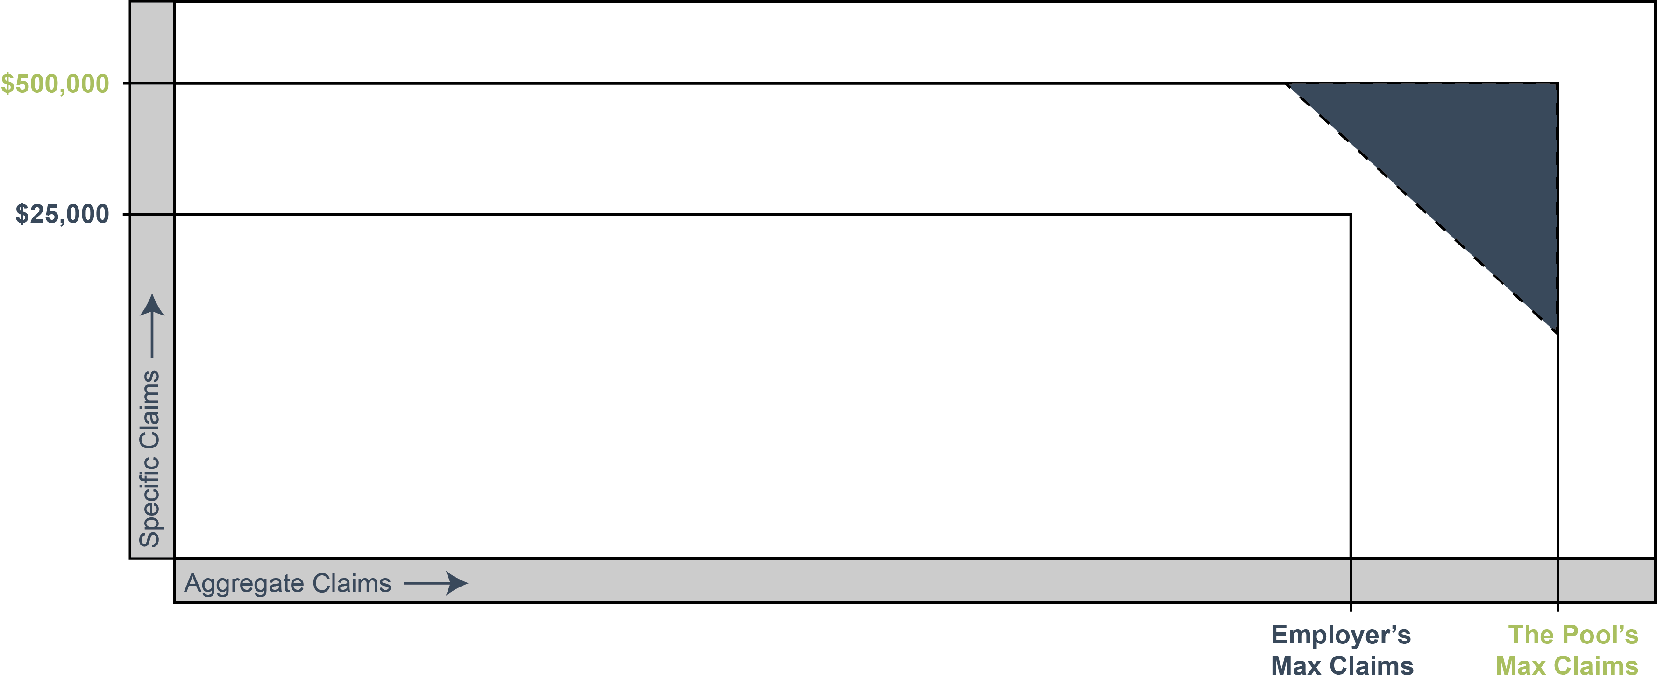
How the Captive Works
Reinsurance (Risk Shifting) = For claims above $500,000 and 125% of expected, reinsurance is purchased.
Pool Premium (Risk Sharing) = For claims between $25,000 and $500,000, employers pool stop loss premiums and claims.
Reserves
Employer Claims Account (Risk Taking) = Each employer will self insure at least $25,000 of claims per member, per policy period.

